Slide 1
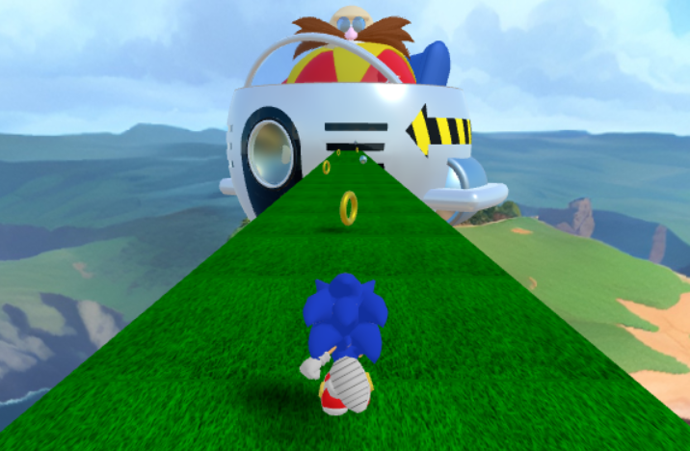

3D Endless Runner
19521432 - Phạm Đức Duy

Slide 2
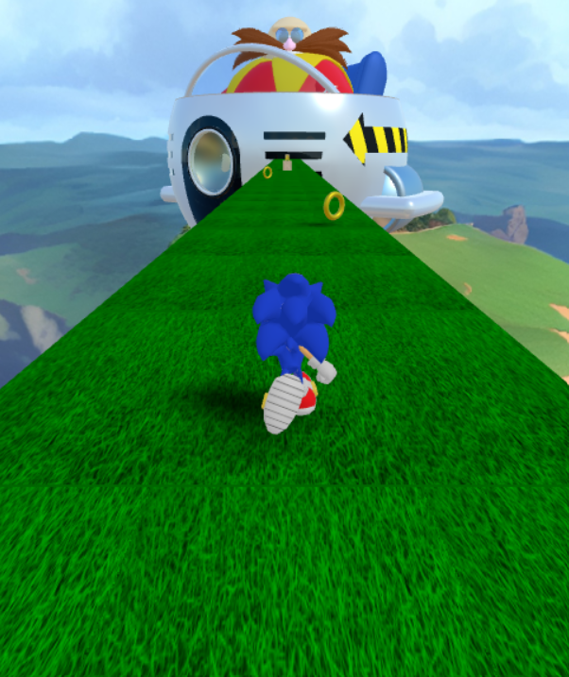

Table of contents
Gameplay Overview
Developed Functionalites
Future Work
Demo

Slide 3
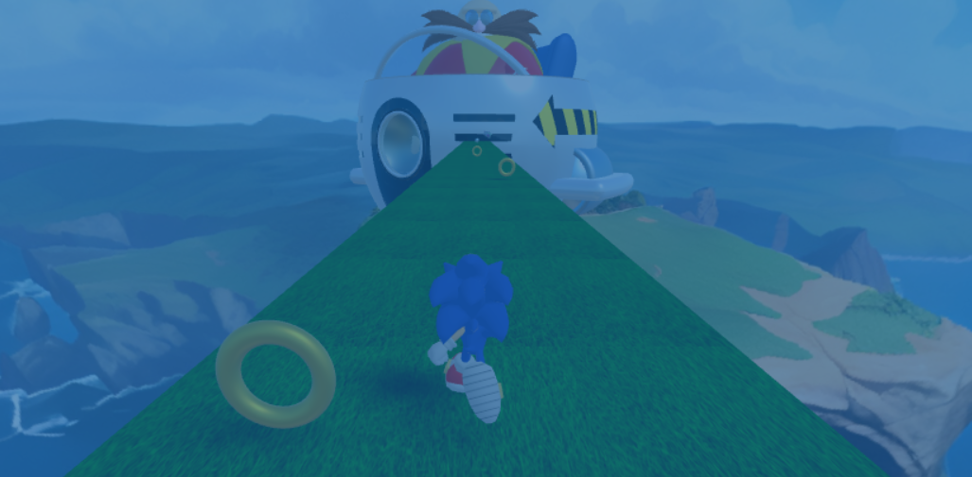
Gameplay Overview

Slide 4
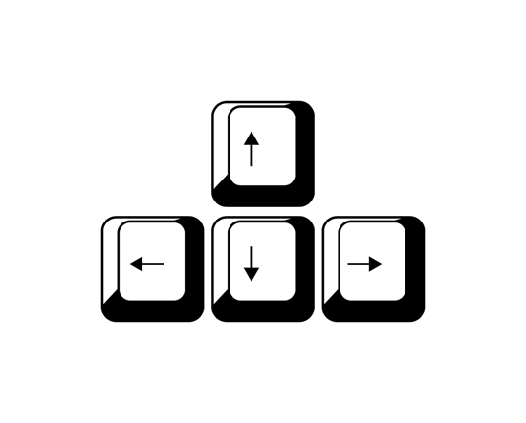
Gameplay Overview
Controls
Objective
Avoiding obstacles and collecting coins to reach a high score.
To control a constantly running character.

Slide 5
Developed Functionalities

Slide 6
Character & State Management
Character: 3D model downloaded from Sketchfab.
State Management:
Extract and turn model’s animations into states.
Add event listeners to listen to keyboard inputs.
Use FSM (Finite-state machine) to manage states and transitions (the change from one state to another).

Slide 7
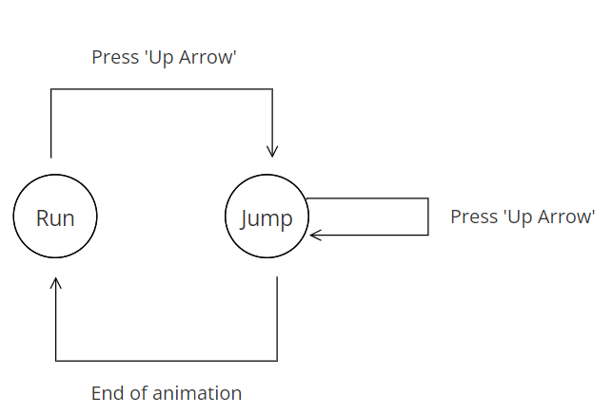
Character & State Management
Example: Use FSM to manage 2 states called “Run” and “Jump”.
In ‘Run’ state, pressing ‘Up Arrow’ key will shift state from ‘Run’ to ‘Jump’.
In ‘Jump’ state, pressing ‘Up Arrow’ key will have no effect. Instead, when the jump animation ends, it will automatically return to ‘Run’ state.
FSM allows to execute some optional functions in-between transitions.
State Diagram

Slide 8
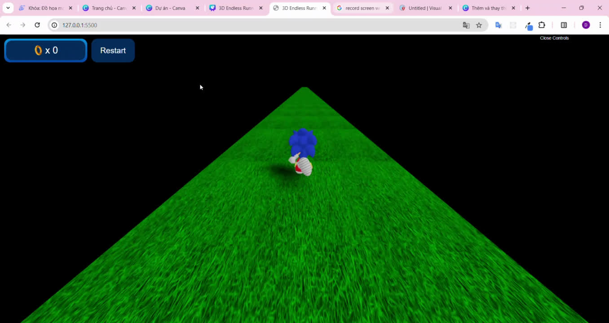
Character & State Management
Developed States: 3 states corresponding to 3 animations of model.
Default: ‘Run’ state.
Press ‘Up Arrow’: ‘Jump’ state.
Press ‘Down Arrow’: ‘Ball’ state.
In ‘Run state’ can press ‘Left Arrow’ or ‘Right Arrow’ to move left or right.

Slide 9
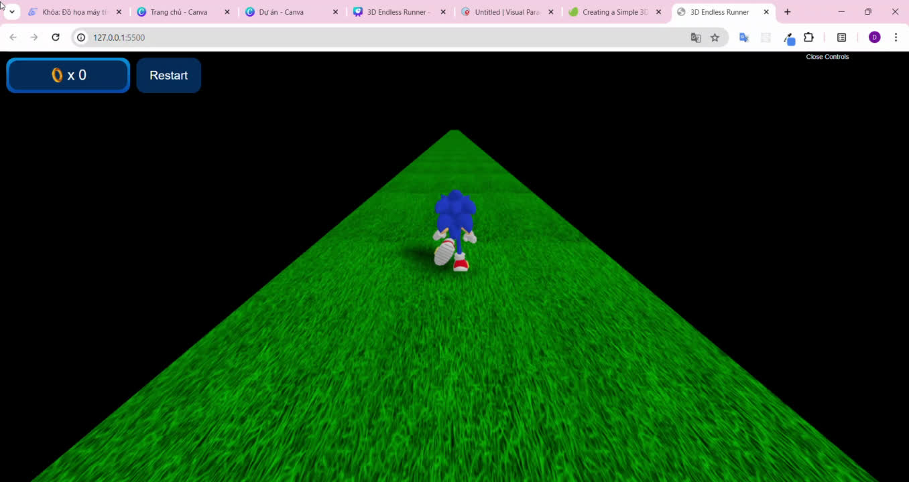
Infinite Moving Plane
To simulate ‘character is running on the infinite plane’:
Apply texture mapping to a plane and shift the texture continuously in vertical direction.
Character will stay still at the initialized position (0, 0, 0) and plays animations.

Slide 10
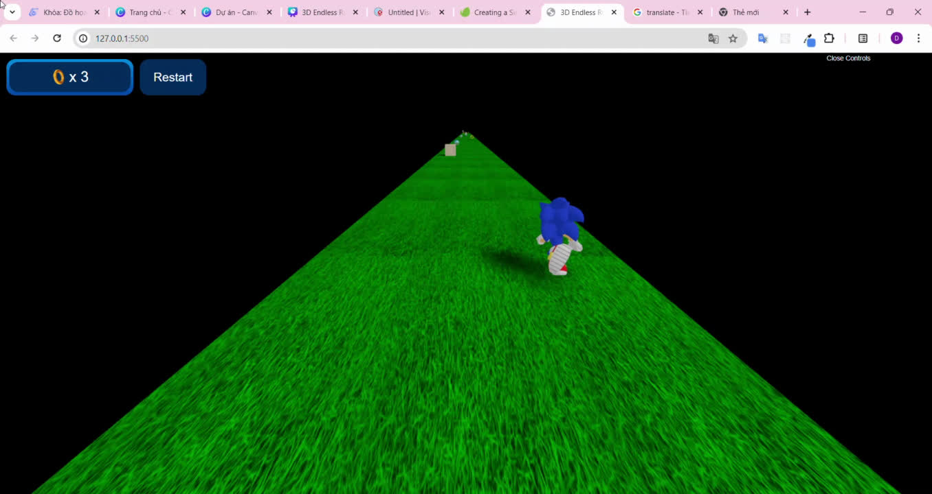
Objects
Objects has 2 type: bonus and obstacle.
Objects are initialized randomly with a certain number.
Objects are shifted as the same speed and direction as the plane’s texture.
When the objects move past or character gains the bonuses, relocate them to new positions on the plane.

Slide 11
Collision Detection
Use THREE.Box3 to represent axis-aligned bounding box (AABB) for character and objects.
The character collides with objects when character’s bounding box intersects with objects’ bounding box.

Slide 12
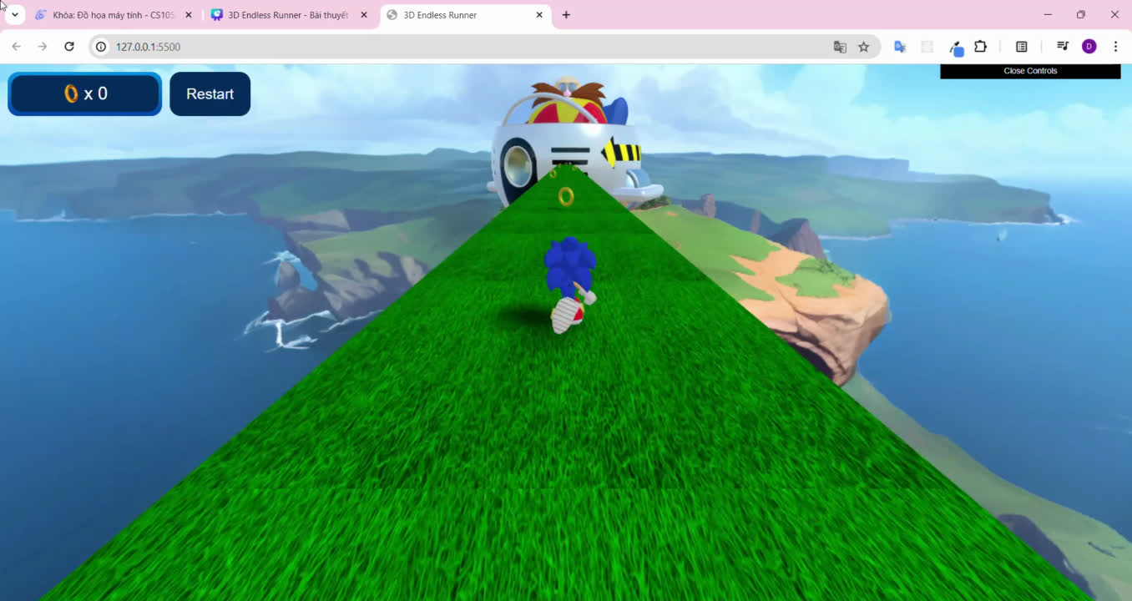
Other works
Apply cube texture to scene’s background.
Apply some texture to objects.
Create some animations for objects.
Add lights.
Apply shadow effect.
Add score system.
...

Slide 13
Future Work

Slide 14

Future Work
Improve game’s performance.
Add more objects as special items.
Add some characters.
Add more animations for character.
...

Slide 15
Demo

Slide 16
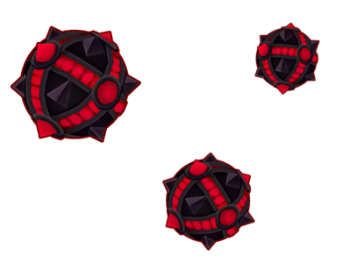


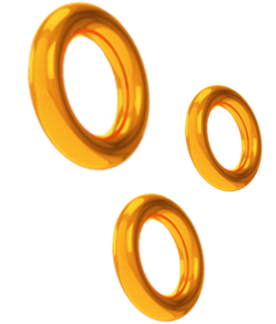
THANK YOU!

